Slide 1
Investigación Clínica
Julia E. Mayer

Slide 2
Hoja de Ruta
Qué es la investigación clínica?
Desarrollo de Fármacos
  Investigación Pre-clínica
  Fases de la Investigación Clínica
Farmacovigilancia
Buena Práctica Clínica
Regulaciones Nacionales e Internacionales
Algunos datos para poner las cosas en contexto
Notes:
Vamos a empezar hablando de qué es la investigación clínica - Cómo se hace, en qué consiste?
Después vamos a hablar un poco de cómo se controla la actividad.
Y finalmente algunos datos para poner las cosas en contexto: Dónde se hace? Dónde y cómo se reclutan pacientes? Qué impacto tiene la actividad en la economía? Y a su vez, qué impacto tiene la economía en la actividad.

Slide 3
Qué es un Estudio Clínico?
Un estudio científico para evaluar la eficacia y la seguridad de un producto de investigación (ej. droga o dispositivo)
Antes de que el producto pueda comercializarse, estos estudios tienen que proveer suficiente cantidad de datos confiables para probar que es efectivo y seguro para uso en seres humanos

Slide 4
Desarrollo de Fármacos
Permiso regulatorio para evaluar en humanos
Permiso regulatorio para comercializar
Etapa Pre-clínica
Fase 1
Fase 2
Fase 3
Fase 4
INVESTIGACIÓN CLINICA

Slide 5
Desarrollo de Fármacos
Permiso regulatorio para evaluar en humanos
Permiso regulatorio para comercializar
Etapa Pre-clínica
Fase 1
Fase 2
Fase 3
Fase 4
INVESTIGACIÓN CLINICA

Slide 6
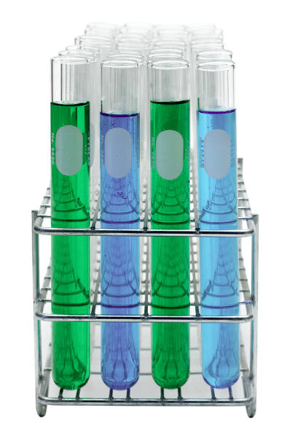
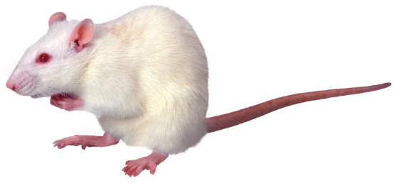
Investigación Pre-clínica
Estudios in vitro
Estudios in vivo (en animales)
Objetivo: obtener evidencia sobre la seguridad de administrar el compuesto a humanos
Notes:
Es necesario obtener evidencia de que el compuesto es biológicamente activo, y se deben evaluar los efectos tóxicos y farmacológicos a través de evaluaciones in vitro e in vivo, en animales de laboratorio.
A newly developed drug can be patented by its owner who then claims their legal rights on this compound and can develop it further into a drug

Slide 7
Investigación Pre-clínica (cont.)
Al menos dos especies de animales
Toxicidad de corto plazo
Toxicidad de largo plazo
Carcinogenicidad
Teratogenicidad
Notes:
2 especies: un roedor y un no roedor (como mínimo)

Slide 8
Desarrollo de Fármacos
Permiso regulatorio para evaluar en humanos
Permiso regulatorio para comercializar
Etapa Pre-clínica
Fase 1
Fase 2
Fase 3
Fase 4
INVESTIGACIÓN CLINICA

Slide 9
IND:
Investigational New Drug Application
Solicitud de autorización a la FDA para comenzar los estudios en humanos
Contiene:
  Datos de Toxicología y Farmacología Animal
  Información de Manufactura
  Protocolos Clínicos e Información sobre los Investigadores
Notes:
Si se comprueba que la investigación preclínica es satisfactoria, el patrocinador del estudio clínico presenta una solicitud de Nuevo Medicamento en Investigación (IND)) a la Administración de Alimentos y Medicamentos de los Estados Unidos (FDA) a fin de solicitar autorización para comenzar los estudios clínicos en humanos. Si se aprueba la solicitud de Nuevo Medicamento en Investigación, los investigadores pueden comenzar a investigar la nueva terapia, lo que incluye una serie de estudios para determinar si existen suficientes pruebas para respaldar el avance a la siguiente fase de investigación.
Contenido de un IND application:
Animal Pharmacology and Toxicology Studies
Preclinical data to permit an assessment as to whether the product is reasonably safe for initial testing in humans.
Manufacturing Information
Information pertaining to the composition, manufacture, stability, and controls used for manufacturing the drug substance and the drug product. This information is assessed as to ensure the company can adequately produce and supply consistent batches of the drug.
Clinical Protocols and Investigator Information
Detailed protocols for proposed clinical studies to assess whether the initial-phase trials will expose subjects to unnecessary risks. Also, information on the qualifications of clinical investigators--professionals (generally physicians) who oversee the administration of the experimental compound--to assess whether they are qualified to fulfill their clinical trial duties.

Slide 10
Desarrollo de Fármacos
Permiso regulatorio para evaluar en humanos
Permiso regulatorio para comercializar
Etapa Pre-clínica
Fase 1
Fase 2
Fase 3
Fase 4
INVESTIGACIÓN CLINICA

Slide 11
Investigación Clínica
Objetivo: determinar la eficacia y seguridad de una intervención* para el diagnóstico, tratamiento o prevención de una enfermedad
*Intervención: Fármaco - Dispositivo - Cirugía - Nutrición – Cambio de comportamiento
Notes:
From this broad spectrum of goals, one of them is to identify the mechanism of the disease process and to determine the effectiveness and safety of an intervention in the disease process.

Slide 12
Investigación Clínica (cont.)
Además de eficacia y seguridad, se determinan:
  Vía y frecuencia de administración
  Formulación
  Posibles combinaciones de terapias

Slide 13
Desarrollo de Fármacos
Permiso regulatorio para evaluar en humanos
Permiso regulatorio para comercializar
Etapa Pre-clínica
Fase 1
Fase 2
Fase 3
Fase 4
INVESTIGACIÓN CLINICA

Slide 14
Estudios Clínicos Fase 1
Primera vez en seres humanos
Pequeños grupos (20-80) de voluntarios sanos
Seguridad – tolerabilidad – farmacocinética – farmacodinámica
Clínicas de internación.
Escalamiento de dosis
PPD Phase I Clinic Tour
Notes:
The whole process of clinical testing is divided into phases, each of which is composed of one or more trials. It is very important to note that there may be some overlap in development from phase I to phase IV. For example a drug may be in Phase II testing for one indication and in Phase II for something different. Also it is not always easy to label a clinical trial as a specific phase. These are just general terms used to describe the development of a new drug.
Phase I:
Phase I trials are the first-stage of testing in human subjects. Normally a small (20-80) group of healthy volunteers will be selected. This phase includes trials designed to assess the safety (Pharmacovigilance), tolerability, pharmacokinetics, and pharmacodynamics of a therapy.
Pharmacokinetics: studies the absorption and disposition of the drug (what the body does to the drug).
Pharmacokdynamics: studies the biochemical and physiological effects of a drug and its mechanism of action (what the drug does to the body).
These trials are almost always conducted in an inpatient clinic, where the subject can be observed by full-time medical staff. The subject is usually observed until several half-lives of the drug have passed. Phase I trials also normally include dose-ranging studies so that doses for clinical use can be refined. The tested range of doses will usually be a small fraction of the dose that causes harm in animal testing. Phase I trials most often include healthy volunteers, however there are some circumstances when patients are used, such as with oncology (cancer) and HIV drug trials. In Phase I trials of new cancer drugs, for example, patients with advanced (metastatic) cancer are used. These trials are usually offered to patients who have had other types of therapy and who have few, if any, other treatment choices.
There are two specific kinds of Phase I trials - SAD studies, and MAD studies.
SAD - Single Ascending Dose studies are those in which groups of three or six patients are given a small dose of the drug and observed for a specific period of time. If they do not exhibit any adverse side effects, a new group of patients is then given a higher dose. This is continued until intolerable side effects start showing up, at which point the drug is said to have reached the Maximum tolerated dose (MTD).
MAD - Multiple Ascending Dose studies are conducted to better understand the pharmacokinetics/pharmacodynamics of the drug. In these studies, a group of patients receives a low dose of the drug and the dose is subsequently escalated up to a predetermined level. Samples (of blood, and other fluids) are collected at various time points and analyzed to understand how the drug is processed within the body.

Slide 15
Desarrollo de Fármacos
Permiso regulatorio para evaluar en humanos
Permiso regulatorio para comercializar
Etapa Pre-clínica
Fase 1
Fase 2
Fase 3
Fase 4
INVESTIGACIÓN CLINICA

Slide 16
Estudios Clínicos Fase 2
Estudio terapéutico piloto
Se realiza después de confirmada la seguridad inicial
Grupos más grandes (~ 100 - 200 pacientes)
Eficacia terapéutica
Seguridad
Farmacocinética
Elección definitiva de la dosis
Notes:
Phase II:
Once the initial safety of the therapy has been confirmed in Phase I trials, Phase II trials are performed on larger groups and are designed to assess clinical efficacy of the therapy; as well as to continue Phase I assessments in a larger group of volunteers and patients. The development process for a new drug commonly fails during Phase II trials due to the discovery of poor efficacy or toxic effects.
Phase II studies are sometimes divided into Phase IIA and Phase IIB. Phase IIA is specifically designed to assess dosing requirements, whereas Phase IIB is specifically designed to study efficacy.
Some trials combine Phase I and Phase II into a single trial, monitoring both efficacy and toxicity.

Slide 17
Desarrollo de Fármacos
Permiso regulatorio para evaluar en humanos
Permiso regulatorio para comercializar
Etapa Pre-clínica
Fase 1
Fase 2
Fase 3
Fase 4
INVESTIGACIÓN CLINICA

Slide 18
Estudios Clínicos Fase 3
Estudio terapéutico ampliado
Evaluación a gran escala en un rango más amplio de pacientes (~ 200 – varios miles)
Meses - años
Eficacia y Seguridad
Calidad de Vida
Notes:
Phase III: this phase is aimed at being the definitive assessment of the efficacy of the new therapy, in comparison with current 'Gold Standard' treatment. Trials in this phase are performed after the drug has been shown to be effective and are intended to gather additional evidence of effectiveness for specific disease indications and more precise definition of drug-related adverse effects and safety. This phase includes both controlled and uncontrolled studies. This is an important turning point for drug manufacturers: the medication has already passed the rigorous testing and review process required by the regulatory authorities such as the FDA, and now it is ready to be studied in an even larger subject population. In recent years, there has been a growing industry trend to not only measure clinical effectiveness at this phase, but also measure “real world” results. For example, if a subject shows clinical improvement after entering the study, how are their activities of daily living improving (e.g., the subject can work in the garden more often or attend their child’s games on a regular basis)?
Most medications that reach Phase III will at least be considered for approval by the regulatory agencies.
There two kinds of studies is this phase:
Phase IIIa: Dose a large population of diseased subjects. This phase may include testing for different indications.
Phase IIIb: This is the phase after requesting regulatory permission to market the drug or after first market launch. It may include testing in different subject populations with varied dosing regimens, or proving additional efficacy for uses beyond the original use for which the drug was designed (“label expansion”). It is essentially a continuation of Phase IIIa.
Once a drug has proven satisfactory over Phase III trials, the trial results are usually combined into a large document containing a comprehensive description of the methods and results of human and animal studies, manufacturing procedures, formulation details, and shelf life. This collection of information makes up the "regulatory submission" that is provided for review to various regulatory authorities in different countries, such as EMEA or FDA, for marketing approval.

Slide 19
Desarrollo de Fármacos
Permiso regulatorio para evaluar en humanos
Permiso regulatorio para comercializar
Etapa Pre-clínica
Fase 1
Fase 2
Fase 3
Fase 4
INVESTIGACIÓN CLINICA

Slide 20
NDA:
New Drug Application
Pedido de aprobación a la FDA para comercializar el nuevo medicamento
Información pre-clínica y clínica
Revisión: 2-3 años
Por Fast Track: 6 meses
Notes:
In a NDA, the drug manufacturer submits non-clinical (animal) and clinical (human) test data and analyses, drug information and description of manufacturing procedures.
It may take 2 to 3 years to obtain approval. In special circumstances (development of drugs that promise significant benefit over existing therapy for serious or life-threatening illnesses for which no therapy exists ) the submission can be made through a fast track. In this case the approval can take ~6 months. The fundamental element of this process is that the manufacturers must continue testing after approval to demonstrate that the drug indeed provides therapeutic benefit to the patient. If not, the FDA can withdraw the product from the market more easily than usual.

Slide 21
NDA:
New Drug Application (cont.)
La FDA revisa la información y evalúa:
  Si la droga es o no segura y efectiva para su uso propuesto
  Si los beneficios son mayores a los riesgos.
  El contenido del inserto y la información en el envase
  Si los métodos de manufactura y control son apropiados para preservar la calidad de la medicación
Notes:
Before moving forward with the NDA submission, a Pre-NDA meeting is held to discuss the presentation of data in support of the application.
Once the NDA is filed, a meeting may occur 90 days after the initial submission of the application in order to discuss issues that are uncovered in the initial review.
The reviewer will attempt to confirm and validate the Sponsor’s conclusion that a drug is safe and effective for its proposed use.
The review may involve a reanalysis or an extension of the analyses performed by the Sponsor.
After the technical reviews are completed, each reviewer will present a written evaluation of the NDA with conclusions and recommendations.

Slide 22
Desarrollo de Fármacos
Permiso regulatorio para evaluar en humanos
Permiso regulatorio para comercializar
Etapa Pre-clínica
Fase 1
Fase 2
Fase 3
Fase 4
INVESTIGACIÓN CLINICA

Slide 23
Estudios Clínicos Fase 4
Medicamento comercializado
Mayor población, largo plazo
Objetivos:
  Efectos farmacológicos específicos
  Incidencia de reacciones adversas
  Efecto de la administración a largo plazo
  Poblaciones especiales
Los resultados podrían llevar a restricciones o retiro del mercado
Notes:
Phase IV: trials are conducted after the national drug registration authority has approved a drug for distribution or marketing. These may include research designed to explore a specific pharmacological effect, to establish the incidence of adverse reactions, or to determine the effects of long-term administration of a drug. Therefore, post-launch safety surveillance can detect any rare or long-term adverse effects over a much larger patient population and timescale than was possible during the initial clinical trials. Such adverse effects detected by Phase IV trials may result in the withdrawal or restriction of a drug. Phase IV trials may also be designed to evaluate a drug in a population not studied adequately in the pre-marketing phases (such as children or the elderly) or to establish a new clinical indication for a drug.
Phase IV studies may be required by regulatory authorities or may be undertaken by the sponsoring company for competitive or other reasons

Slide 24
Farmacovigilancia
Ciencia y actividades relacionadas con la detección, evaluación, comprensión y prevención de efectos adversos u otros posibles problemas relacionados con fármacos
OMS 2002
Notes:
Pharmacovigilance is intended to constantly evaluate drugs marketed with or without medical prescription, by identifying and quantifying risks, and besides using population analysis techniques that have a pharmacoepidemiological basis.
The thalidomide affair of the 1950s gave rise to considerable national and international legislation for the registration and monitoring of prescription medicines. This monitoring - known as 'pharmacovigilance' - is necessary since by no means all of a medicine's effects are known at the time of its introduction. The clinical trials prior to licensing usually involve relatively small groups of patients, who may have been specifically selected to take part in these trials. General use of the medicine, involving large groups of diverse patients, may therefore reveal hitherto unknown side effects. These may be caused by interaction with other medicines, the presence of certain concurrent diseases, or may be seen only in the very young or elderly. Rare side effects may only come to light after long-term frequent usage.
The cornerstone of pharmacovigilance is a global network of national systems by which side effects ('adverse drug reactions') can be reported.

Slide 25
Farmacovigilancia (cont.)
Notificación, registro y evaluación sistemática de las reacciones adversas producidas por los medicamentos
Espontánea vs. obligatoria
Papel de la autoridad sanitaria

Slide 26







Animal and
Laboratory Testing
Laboratory Testing
Pre-Clinical
Sponsor
Discovery
IND
Regulatory Approval to Begin
Testing in Humans
Profits return to
the Sponsor
Post-Marketing
Phase 1
After-Market Testing
Clinical
Phase 2
Investigational Product
Is Marketed To the Public
Regulatory Approval to Market
the Investigational Product
Phase 3a
NDA/MAA
Approval
Phase 3b
Submission
NDA/MAA
Notes:
26
26
26
Here is a brief pictorial overview of what we just discussed:
This Drug Development cycle (shown here in the form of a clock face) starts with the SPONSOR (around 11:00).
IND = Investigational New Drug
NDA = New Drug Application
MAA = Marketing Authorization Application
Summarising the research period in the development of a drug, it is remarkable that it may take up to 15 years to get a product from the moment of it’s granted patent to the launch on the market, taken into account that a patent’s life will end after about 20 years.
It is more remarkable that approximately only 1 in 10,000 compounds will be finally launched on the market. Most of them fail in the first phase of clinical research due to safety issues.
It is probably most remarkable that the development of 1 compound might cost a pharmaceutical company nearly up to $800 Million US Dollars.
Are there any questions before we leave this section?

Slide 27
BUENA PRÁCTICA CLÍNICA
EN INVESTIGACIÓN FARMACOLÓGICA

Slide 28
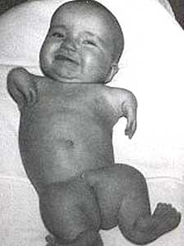
Buena Práctica Clínica: Historia
Algunos antecedentes:
  Dietilenglicol - 1937 USA, 1992 Argentina
  Estudio de Tuskegee - 1932 – 1972
  Experimentos con prisioneros - 1939 – 1944
  Talidomida - 1957 – 1961
Notes:
Diethylene glycol has several industrial uses but has also been used as an adulterant (for example, in medicines and wines) and been responsible for a number of mass poisonings. The most famous incident was the 1937 Elixir Sulfanilamide disaster in the USA, in which 107 people died after taking sulfanilamide dissolved in diethylene glycol. In Haiti in 1996, 85 children died through glycerine contaminated with diethylene glycol in a paracetamol syrup. In 1985 in Austria, diethylene glycol appeared to be added as a wine adulterant. In 2006 in Panama, it was detected toxic levels of diethylene glycol in an expectorant, which resulted in 32 deaths.
Tuskegee Syphilis Study (1932- 1972)
The Tuskegee, Alabama study was conducted to observe the natural long-term effect of syphilis on untreated subjects. The subjects were 399 mostly poor and rural African-American men who had contracted syphilis. In 1947, penicillin was established as an effective treatment for syphilis. Tuskegee researchers chose not to provide penicillin to study participants in the interest of continuing the study. In addition, government officials did not intervene. These facts were held in secret until journalists exposed them in 1972. By then, of the 399 infected participants, 28 had died of syphilis and another 100 had died from medical complications related to syphilis. In addition, 40 wives of participants had been infected with syphilis, and 19 children had contracted the disease at birth.
Nazi Concentration Camp Experimentation (1939 - 1944)
During World War II, Nazis implemented plans to control and eradicate individuals and communities they judged inferior based on nationalistic theory of Eugenics (Nazi officials believed that Europe's gene pool must be purified by eliminating people with "inferior" genes). The primary victims of the plan were European Jews, people from Slavic countries, the mentally and physically ill and political dissidents.
The Nazis implemented the plan by transporting and concentrating the "inferior" en mass to labor and processing camps. In addition to slave labor and extermination, the camps were a ready source of human subjects for Nazi eugenics and other quasi-scientific experimentation. Participation in the experiments was forced. No consideration was given for the rights, safety, and well being of the subjects.
Dash 1 - Twins:
Joseph Mengele was the leader of these experiments. He would select twins and place them in special barracks.
Mengele placed 14 pairs of Roma twins on his polished marble dissection table and put them to sleep. He then proceeded to inject chloroform into their hearts, killing them instantly. Mengele then began dissecting and meticulously noting each and every piece of the twins' bodies
Two Gypsy children were sewn together to create Siamese twins; the hands of the children became badly infected where the veins had been resected
Dash 2 - Freezing:
In 1941 the Luftwaffe conducted experiments to learn how to treat hypothermia. One study forced subjects to endure a tank of ice water for up to three hours. Another study placed prisoners naked in the open for several hours with temperatures below freezing. The experimenters assessed different ways of re-warming survivors
Dash 3 - Malaria: Prisoners were intentionally infected with Malaria and then used as test subjects for various treatments
Dash 4 - Sulfonamide:
Sulfonamide is a synthetic antimicrobial agent. Wounds inflicted on the subjects were infected with bacteria such as Streptococcus, gas gangrene, and tetanus. Circulation of blood was interrupted by tying off blood vessels at both ends of the wound to create a condition similar to that of a battlefield wound. Infection was aggravated by forcing wood shavings and ground glass into the wounds. The infection was treated with sulfonamide and other drugs to determine their effectiveness.
Dash 5 – Sea Water:
Purpose was to study various methods of making sea water drinkable. At one point, a group of roughly 90 Roma were deprived of food and given nothing but sea water to drink, leaving them gravely injured. They were so dehydrated that others observed them licking freshly mopped floors in an attempt to get drinkable water.
Dash 6 – Sterilization:
The purpose of these experiments was to develop a method of sterilization which would be suitable for sterilizing millions of people with a minimum of time and effort. Injections of solutions speculated to contain iodine and silver nitrate were successful, but had unwanted side effects such as vaginal bleeding, severe abdominal pain, and cervical cancer. Radiation treatment became the favored choice of sterilization. The radiation was administered through deception. Prisoners were brought into a room and asked to complete forms, which took two to three minutes. In this time, the radiation treatment was administered and, unknown to the prisoners, they were rendered completely sterile. Many suffered severe radiation burns.
Japan Dash 1 – Freezing:
To determine the treatment of frostbite, prisoners were taken outside in freezing weather and left with exposed arms, periodically drenched with water until frozen solid. The arm was later amputated; the doctor would repeat the process on the victim’s upper arm to the shoulder. After both arms were gone, the doctors moved on to the legs until only a head and torso remained. The victim was then used for plague and pathogens experiments.
Ethical Issues Today
The modern body of medical knowledge about how the human body reacts to freezing to the point of death is based almost exclusively on these Nazi experiments. This, together with the recent use of data from Nazi research into the effects of phosgene gas, has proved controversial and presents an ethical dilemma for modern physicians who do not agree with the methods used to obtain these data.
Thalidomide is a sedative, hypnotic, and anti-inflammatory medication. It was sold from 1957 to 1961 in almost 50 countries under at least 40 names (Distaval, Talimol, Nibrol, Sedimide, Quietoplex, Contergan, Neurosedyn, and Softenon). Thalidomide was chiefly sold and prescribed during the late 1950s and 1960s to pregnant women, as an antiemetic to combat morning sickness and as an aid to help them sleep. Unfortunately, inadequate tests were performed to assess the drug's safety, with catastrophic results for the children of women who had taken thalidomide during their pregnancies. From 1956 to 1962, approximately 10,000 children were born with severe malformities, including phocomelia, because their mothers had taken thalidomide during pregnancy.
Phocomelia is a birth defect that can be genetically transmitted or may be cause by toxins taken during pregnancy. Major symptoms are: growth and mental deficiencies - defects in the eyes, ears, and nose - and characteristic deficient limb development affecting the arms and legs.

Slide 29
Regulaciones Nacionales
Food & Drug Administration (1937)
Legislación en Europa (1960’s)
Latinoamérica:
  Mexico (1986)
  Brasil (1988)
  Argentina (1997)
  Chile (2001)
  Perú (2006)
Notes:
Las fechas muestran los comienzos – naturalmente, hubo actualizaciones y cambios a medida que pasaron los años.

Slide 30
Regulaciones Internacionales
Objetivos:
  Maximizar la eficiencia del proceso de desarrollo de fármacos
  Evitar la duplicación de la investigación
    Tiempo
    Dinero
  Unificación de requisitos
Notes:
The reasons for the globalisation of regulations was to prevent the duplication of testing and research and thus time and money (also for an ethical issue that prevents from using more human beings as experimental subjects than strictly necessary) and to allow the making of a ‘core set of technical data’ for safety and efficacy in a global dossier.
In turn, globalisation of studies results also from the need to obtain a large number of patients in a short period of time. This is important when the incidence of the disease is low or very low, and critical in very rare diseases.

Slide 31
Regulaciones Internacionales: Antecedentes
Código de Nuremberg (1947)
Declaración Universal de los Derechos Humanos (1948)
Declaración de Ginebra (1948)
Declaración de Helsinki (1964)
Notes:
The international regulations are founded on these documents issued in the 40’s, that we will describe shorty, as a result of the serious violations to human rights that occurred during WW II.

Slide 32
ICH:
International Conference of Harmonization
Miembros:
  Autoridades Regulatorias e Industria Farmacéutica de EU, USA y Japón
Observadores:
  OMS
  Asociación Europea de Libre Comercio
  Canadá
Creado en 1990
Notes:
ICH is the acronym for the International Conference on Harmonisation of Technical Requirements for Registration of Pharmaceuticals for Human Use (ICH). It is a project that brings together the regulatory authorities of Europe, Japan and the United States and experts from the pharmaceutical industry in the three regions to discuss scientific and technical aspects of pharmaceutical product registration.
The purpose of ICH is to reduce or obviate the need to duplicate the testing carried out during the research and development of new medicines by recommending ways to achieve greater harmonisation in the interpretation and application of technical guidelines and requirements for product registration.
Harmonisation would lead to a more economical use of human, animal and material resources, and the elimination of unnecessary delay in the global development and availability of new medicines while maintaining safeguards on quality, safety, and efficacy, and regulatory obligations to protect public health.
In the 1980s, what is today the European Union began harmonising regulatory requirement. In 1989, Europe, Japan, and the United States began creating plans for harmonisation; ICH was created in April 1990 at a meeting in Brussels, Europe.
Six parties that represent the regulatory bodies and the research-based industries of the founding members are responsible for the decision making process: the European Union, the European Federation of Pharmaceutical Industries and Associations (EFPIA), the Ministry of Health, Labour and Welfare, the Japan Pharmaceutical Manufacturers Association (JPMA), the Food and Drug Administration (FDA), and the Pharmaceutical Research and Manufacturers of America (PhRMA).
In many countries, national or federal regulations regarding the conduct of clinical trials and the marketing of pharmaceutical products matured between the 1960 and 1990s. Regulations focused on the local (national) market. As a result, ethical, statistical, data, GXPs, and medical terminology varied from country to country.
Throughout the 20th century, as with other industries, pharmaceutical research, development, and marketing became an increasing global enterprise. However, the pharmaceutical industry's realization of the benefits of global and integrated markets was hampered by regulations that were country-specific and in some cases incompatible.
Country-specific standards led to differences in quality and limited acceptability of clinical trial data. Data from clinical trials conducted in country A could not be accepted in country B. Trials had to be repeated increasing costs and potentially putting more Subjects at risk.
This lack of commonly accepted ethical, scientific, and regulatory standards resulted in higher costs and restricted the availability of drugs.

Slide 33
ICH:
International Conference of Harmonization (cont.)
Objetivo:
  Facilitar el proceso de desarrollo de fármacos en todo el mundo a través de la armonización de los requerimientos técnicos para registrar fármacos para uso humano
Publicación de Guías
Notes:
ICH is the acronym for the International Conference on Harmonisation of Technical Requirements for Registration of Pharmaceuticals for Human Use (ICH). It is a project that brings together the regulatory authorities of Europe, Japan and the United States and experts from the pharmaceutical industry in the three regions to discuss scientific and technical aspects of pharmaceutical product registration.
The purpose of ICH is to reduce or obviate the need to duplicate the testing carried out during the research and development of new medicines by recommending ways to achieve greater harmonisation in the interpretation and application of technical guidelines and requirements for product registration.
Harmonisation would lead to a more economical use of human, animal and material resources, and the elimination of unnecessary delay in the global development and availability of new medicines while maintaining safeguards on quality, safety, and efficacy, and regulatory obligations to protect public health.
In the 1980s, what is today the European Union began harmonising regulatory requirement. In 1989, Europe, Japan, and the United States began creating plans for harmonisation; ICH was created in April 1990 at a meeting in Brussels, Europe.
Six parties that represent the regulatory bodies and the research-based industries of the founding members are responsible for the decision making process: the European Union, the European Federation of Pharmaceutical Industries and Associations (EFPIA), the Ministry of Health, Labour and Welfare, the Japan Pharmaceutical Manufacturers Association (JPMA), the Food and Drug Administration (FDA), and the Pharmaceutical Research and Manufacturers of America (PhRMA).
In many countries, national or federal regulations regarding the conduct of clinical trials and the marketing of pharmaceutical products matured between the 1960 and 1990s. Regulations focused on the local (national) market. As a result, ethical, statistical, data, GXPs, and medical terminology varied from country to country.
Throughout the 20th century, as with other industries, pharmaceutical research, development, and marketing became an increasing global enterprise. However, the pharmaceutical industry's realization of the benefits of global and integrated markets was hampered by regulations that were country-specific and in some cases incompatible.
Country-specific standards led to differences in quality and limited acceptability of clinical trial data. Data from clinical trials conducted in country A could not be accepted in country B. Trials had to be repeated increasing costs and potentially putting more Subjects at risk.
This lack of commonly accepted ethical, scientific, and regulatory standards resulted in higher costs and restricted the availability of drugs.

Slide 34
ICH-GCP:
Buena Práctica Clínica
Estándar internacional ético y científico para diseñar, conducir, registrar y reportar estudios que impliquen la participación de seres humanos, para la aceptación mutua de datos entre países.
Objetivos:
  Asegurar la protección y los derechos de los sujetos experimentales
  Asegurar la credibilidad de los datos
Notes:
The objective of the ICH-GCP Guidelines is to provide a unified standard for the European Union (EU), Japan and the United States to facilitate the mutual acceptance of clinical data by the regulatory authorities in these jurisdictions; therfore, these guidelines should be followed when generating clinical trial data are intended to be submitted to regulatory authorities.
The guideline was developed with consideration of the current good clinical practices of the European Union, Japan, and the United States, as well as those of Australia, Canada, the Nordic countries and the World Health Organization (WHO).
Compliance with this standard provides public assurance that the rights, safety and well-being of trial subjects are protected, consistent with the principles that have their origin in the Declaration of Helsinki, and that the clinical trial data are credible.
The principles established in this guidelines may also be applied to other clinical investigations that may have an impact on the safety and well-being of human subjects.

Slide 35
Principios de ICH-GCP
Principios éticos: Helsinki, GCP y requerimientos regulatorios
Riesgos/inconvenientes previstos vs potencial beneficio para el individuo y la sociedad
Los derechos, la seguridad y el bienestar de los pacientes del estudio son las consideraciones más importantes, y prevalecen por sobre los intereses de la ciencia y la sociedad
Notes:
Clinical trials should be conducted in accordance with the ethical principles that have their origin in the Declaration of Helsinki, and that are consistent with GCP and the applicable regulatory requirement(s).
Before a trial is initiated, foreseeable risks and inconveniences should be weighed against the antecipated benefit for the individual trial subject and society. A trial should be initiated and continued only if the anticipated benefits justify the risks
The rights, safety, and well-being of the trial subjects are the most important considerations and should prevail over interests of science and society.
The available non-clinical and clinical information on an investigational product should be adequate to support the proposed clinical trial.
Clinical trials should be scientifically sound, and described in a clear, detailed protocol.

Slide 36
Principios de ICH-GCP (cont.)
Información no-clínica y clínica previa
Solidez científica
Aprobación de un Comité de Revisión Institucional o Comité Independiente de Ética
Médico calificado
Personal calificado
Notes:
The available non-clinical and clinical information on an investigational product should be adequate to support the proposed clinical trial.
Clinical trials should be scientifically sound, and described in a clear, detailed protocol.
A trial should be conducted in compliance with the protocol that has received prior institutional review board (IRB)/independent ethics committee (IEC) approval/favourable opion (stop here to mention the equivalent of an IRB or EC in your country)
The medical care given to, and medical decisions made on behalf of subjects should always be the responsability of a qualified physician.
Each individual involved in conducting a trial should be qualified by education, training, and experience to perform his or her respective task(s).

Slide 37
Principios de ICH-GCP (cont.)
Consentimiento Informado
Manejo de la información - exactitud en el reporte, la interpretación y la verificación de los datos
Confidencialidad de los registros
Producto en Investigación - GMP
Sistemas de aseguramiento de la calidad
Notes:
Freely given informed consent should be obtained from every subject prior to clinical trial participation.
All clinical trial information should be recorded, handled, and stored in a way that allows its accurate reporting, interpretation and verification.
The confidentiality of records that could indentify subjects should be protected, respecting the privacy and confidentality rules in accordance with the applicable regulatory requirements(s).
Investigational products should be manufactured, handled, and stored in accordance with applicable good manufacturing practice (GMP). They should be used in accordance with the approval protocol.
Systems with procedures that assures the quality of every aspect of the trial should be implemented.

Slide 38
Consentimiento Informado
Proceso por el cual una persona confirma en forma voluntaria su deseo de participar en un estudio clínico, después de haber sido informado de todos los aspectos del estudio que son relevantes para su decisión de participar
El CI se documenta a través de un formulario escrito, firmado y fechado

Slide 39
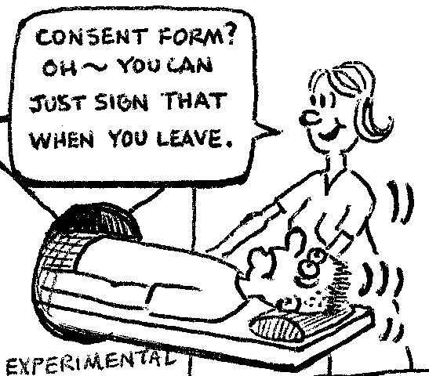
Notes:
El Consentimiento Informado se firma obviamente antes de participar en la investigación!

Slide 40
SUPERVISIÓN DE ENSAYOS CLÍNICOS EN ARGENTINA

Slide 41
Actores
Comités de Ética
ANMAT: Administración Nacional de Medicamentos, Alimentos y Tecnología Médica
Autoridades Provinciales

Slide 42
Instancias de control
Revisión Inicial
Revisión Continua
Reportes de Avance y Finales
Inspecciones y auditorías
Notes:
For a trial to be run at a site, all these entities need to approve it and review on an ongoing basis
Initial Review: An approval must be granted to the protocol, ICF and any written documentation to be provided to subjects prior to the start of the trial
Ongoing Review
Examples:
- Protocol or ICF Changes/Amendments
- SAEs
- Safety Reports
The local committees, IEC or ANMAT can decide to stop a trial if they consider it is necessary to protect patients’ safety.
Interim and Final Reports
It is the principal investigator’s responsibility to submit interim and final reports within the time periods established by IEC, ANMAT and local committees, at least on a six-monthly basis.

Slide 43
Dónde se hace investigación clínica?
O… cómo derribar algunos mitos

Slide 44
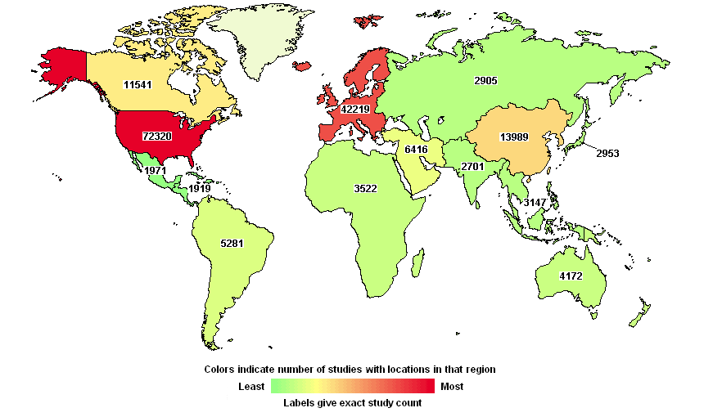
Notes:
Estos son los estudios registrados – no todos están activos en este momento. Los datos incluyen estudios por empezar, y otros ya completados.

Slide 45
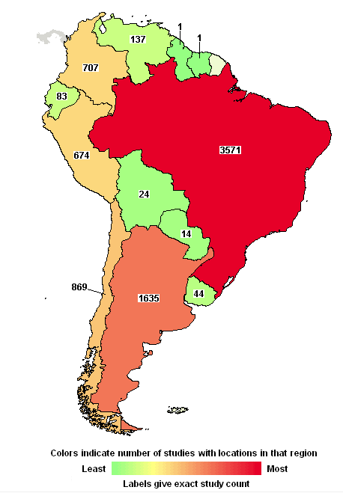

Slide 46
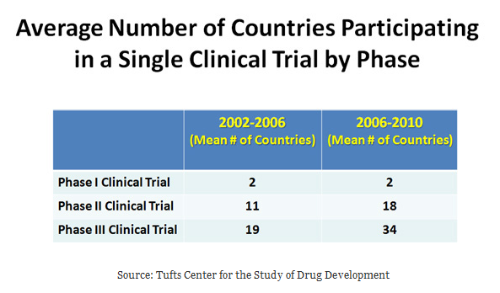

Slide 47
Cuántas drogas se investigan?

Slide 48
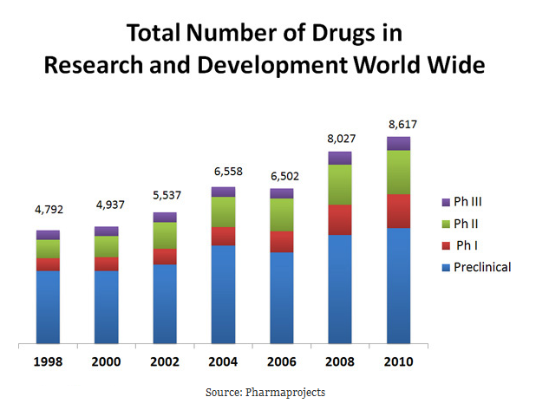

Slide 49
Cuánto cuesta?

Slide 50
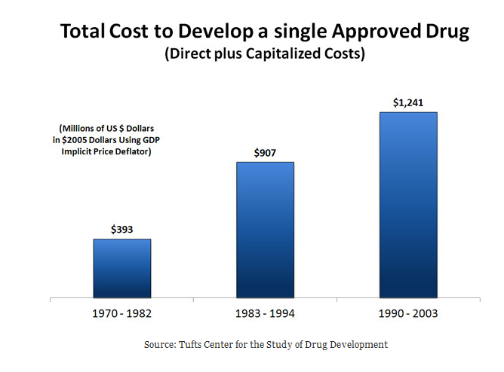

Slide 51
Qué tipo de pacientes y Cuántos se enrolan?

Slide 52
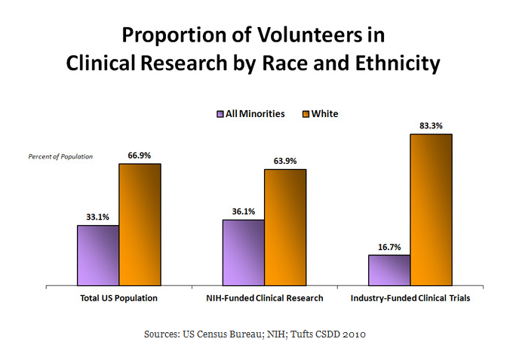

Slide 53
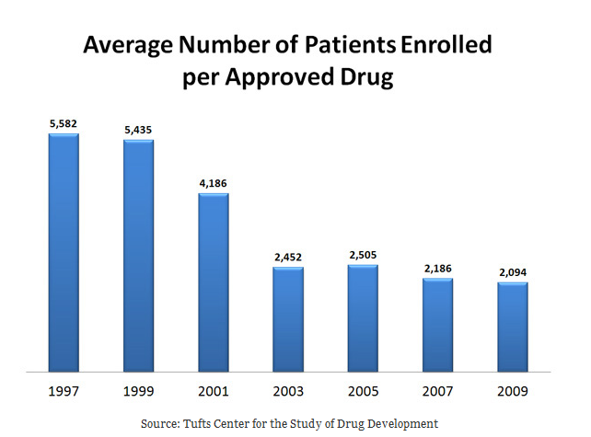

Slide 54
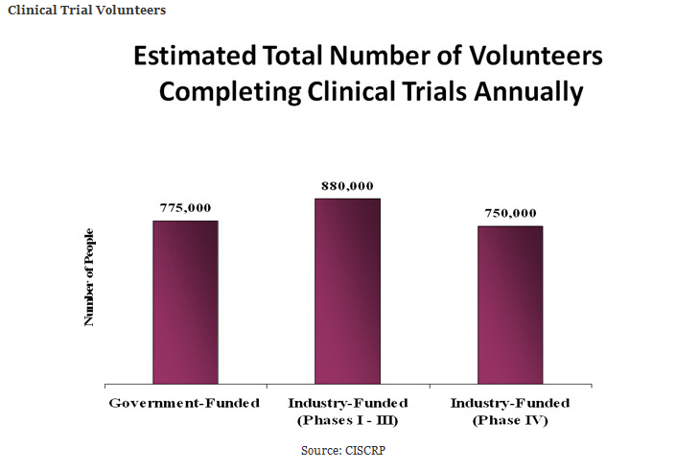

Slide 55
ejemplos

Slide 56
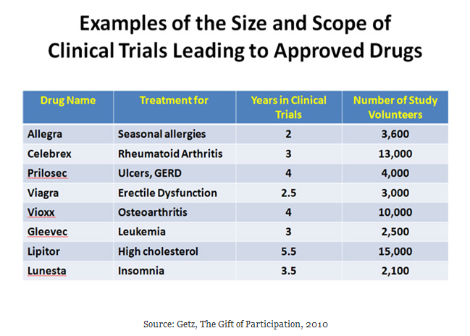

Slide 57
Preguntas?

